Slide 1
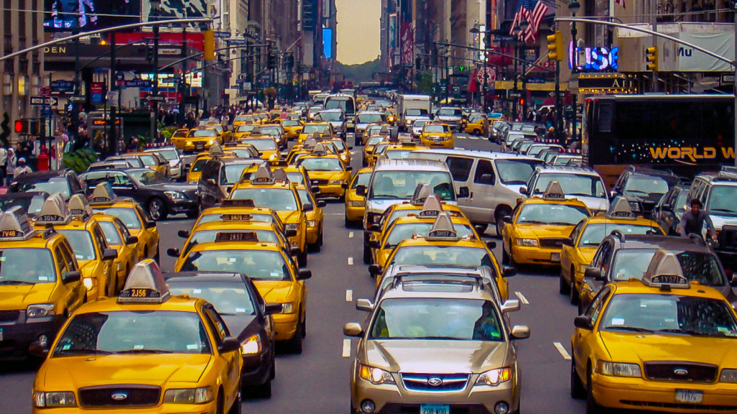
Studying Street Safety in NYC
Jordan Zandi & Jason Goode
Final Project, MPCS 53120
Due: 5/29/18

Slide 2
Contents
Overview
Data
Methods/Analysis
Results
Interpretation

Slide 3
Overview
Overview
Introduction: Vision Zero is NYC’s primary policy initiative to reduce traffic-related injuries and fatalities. This includes street design, outreach, enforcement, legislation, and campaigns. We are focused on street design
Objective: Study the relationship between NYCDOT’s street design safety measures and traffic-related injuries/fatalities
Hypothesis: NYCDOT’s traffic safety initiatives (detailed below) have a statistically significant reductive impact on the odds of fatality and the incidence of injury.

Slide 4

Data (Accidents)
Data
Source:
Description: 4 CSVs of fatality and injury counts by month, year, and type.
Includes latitude and longitude coordinates of nearest intersection where accident occured
41,466 injuries occurred in NYC in 2016

Slide 5
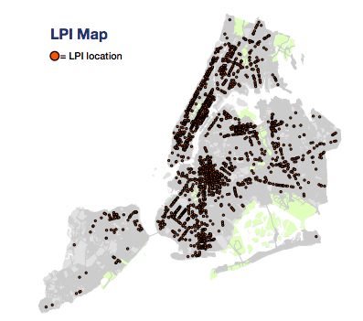
Data (GeoSpatial)
Data
Source:
Description:
Basemap: Shapefile (.shp) coordinates of every street and intersection in NYC
Street Attributes: 14 GeoJSONs that map locations of street attributes
EX: Leading Pedestrian Intervals
We recorded 128,000 intersections in NYC

Slide 6
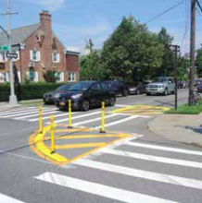
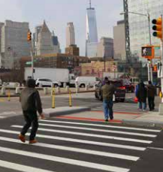
Data (Predictors & Outcomes)
Data
Predictors
Arterial Slow Zones
Enhanced Crossings
Leading Pedestrian Intervals
Street Improvement Corridors/Intersections
Left Turn Traffic Calming
Speed Humps
Safe Streets for Seniors
Neighborhood Slow Zone
Month
Enhanced Crossing
Slow Zones
Leading Pedestrian Interval
Outcomes
Cyclist
Injuries / Fatalities
Motor Vehicle
Injuries / Fatalities
Pedestrian
Injuries / Fatalities

Slide 7
Wrangling GeoSpatial Data
Data
Intersection (x,y)
Equals?
Lies within?
Lies on?
Point
(x,y)
LineString
Polygon
Binary Classification (T/F)

Slide 8
Methods
Analysis
Multiple Logistic Regressions
Decision Trees
Predictive Model

Slide 9
Data (Predictors)
Arterial Slow Zones
Left Turn Traffic Calming
Speed Humps
Enhanced Crossings
Safe Streets for Seniors
Leading Pedestrian Intervals
The Neighborhood Slow Zone
Street Improvement Corridors
Priority Corridors
Month

Slide 10
Data (GeoSpatial)
Data
Base Map
Shapefile (.shp) of every street and intersection in NYC
~128,000 intersections (rows in our CSV)
Accident & Street Attribute Data
4 CSVs of fatality and injury data by month and type, with corresponding lat/lon
14 GeoJSONs that define map locations of street attributes
EX: Leading Pedestrian Intervals

Slide 11
Data (Predictors)
Arterial Slow Zone program uses a combination of a lower speed limit, signal timing changes, distinctive signs and increased enforcement to improve safety on some of New York City's most high-crash corridors.
Intersections where DOT installs traffic calming measures that guide drivers to turn left at a safer speed and angle, as well as increase visibility for pedestrians in the crosswalk.
Speed Humps are a raised area of a roadway designed to reduce vehicle speeds. Dates reflect the first time a speed hump was installed at a location
Enhanced Crossings are marked high-visibility crosswalks on calm streets with low vehicle volumes and a strong pedestrian desire to cross
The Safe Streets for Seniors program is an initiative aimed at increasing safety for older New Yorkers.
Intersections where DOT installs signals that show a walk sign for pedestrians before showing a green light to vehicle traffic
The Neighborhood Slow Zone program is an application based program which takes a neighborhood area and reduces the speed limit to 20 mph
Street Improvement Projects (SIPs) (corridors and intersections) Safety-oriented engineering improvements that use multiple treatments (signals, markings, concrete etc) on both corridors and intersections
Priority Corridors where the signal progression has been changed to match the 25 MPH speed limit.

Slide 12
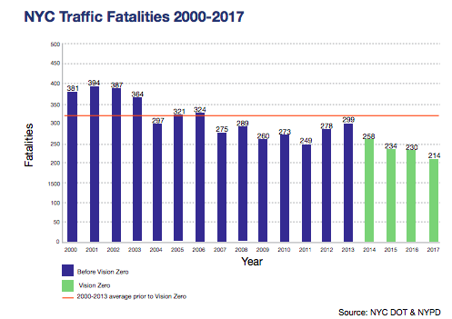
Overview
Overview
Introduction: Vision Zero is NYC’s primary policy initiative to reduce traffic-related injuries and fatalities. This include various street design, outreach, enforcement, legislation, and campaigns.
Objective: Study the relationship between NYCDOT’s street design safety measures and traffic-related injuries
Hypothesis: NYCDOT’s traffic safety initiatives (detailed below) have a statistically significant reductive impact on the odds of fatality and the incidence of injury.
NYC Traffic Fatalities (Yearly)

Slide 13
Raw Data (Inputs)
Data
Base Map
Shapefile (.shp) of every street and intersection in NYC
~128,000 intersections (rows in our CSV)
Accident & Street Attribute Data
4 CSVs of fatality and injury data by month and type, with corresponding lat/lon
14 GeoJSONs that define map locations of street attributes
EX: Leading Pedestrian Intervals

Slide 14
Methods

Slide 15
Results

Slide 16
Interpretation

Slide 17
Key Takeaways

